Slide 1
MIL, SIL, PIL and HIL Testing​​

Slide 2
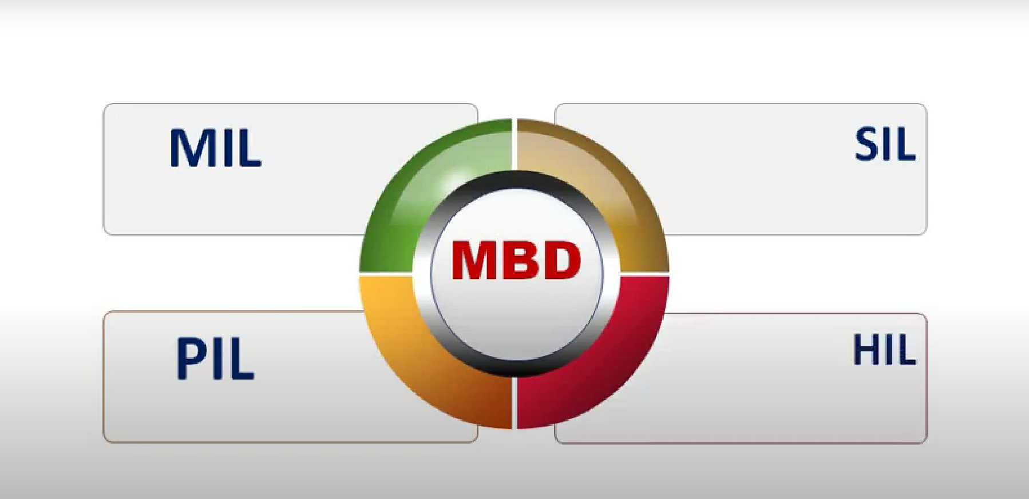
Phases of MBD?

Slide 3
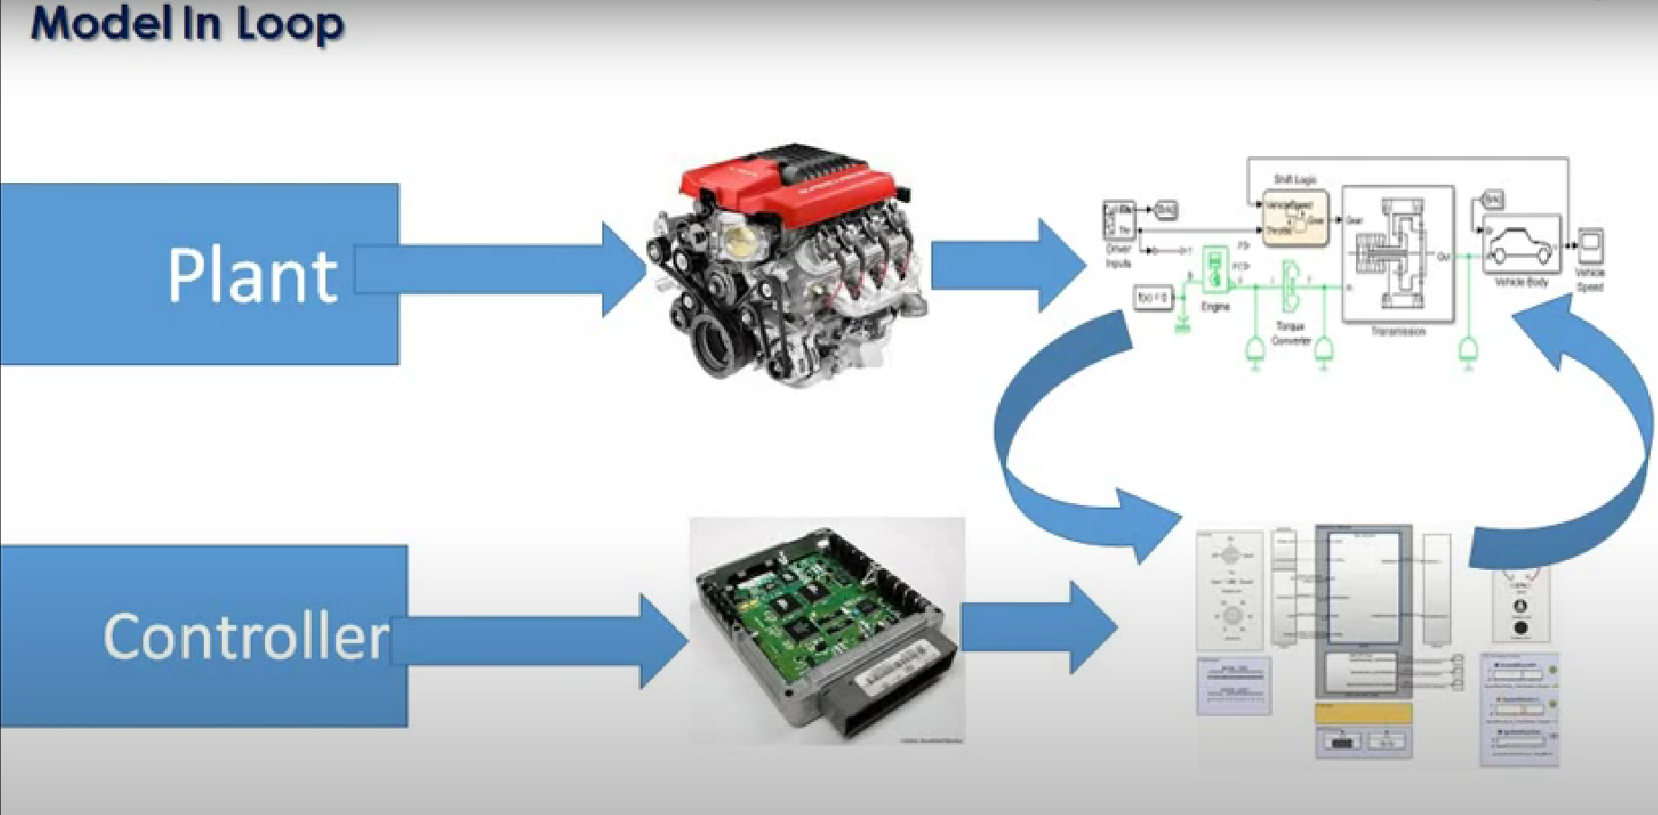
Model in Loop (MIL)
MIL:
Plan model and Controller
First, Develop Plan model (hardware) in a simulation environment such as Simulink, which captures most of the important features of the hardware system
Second, Develop the controller model and verify if the controller can control the plant model as per the requirement.

Slide 4
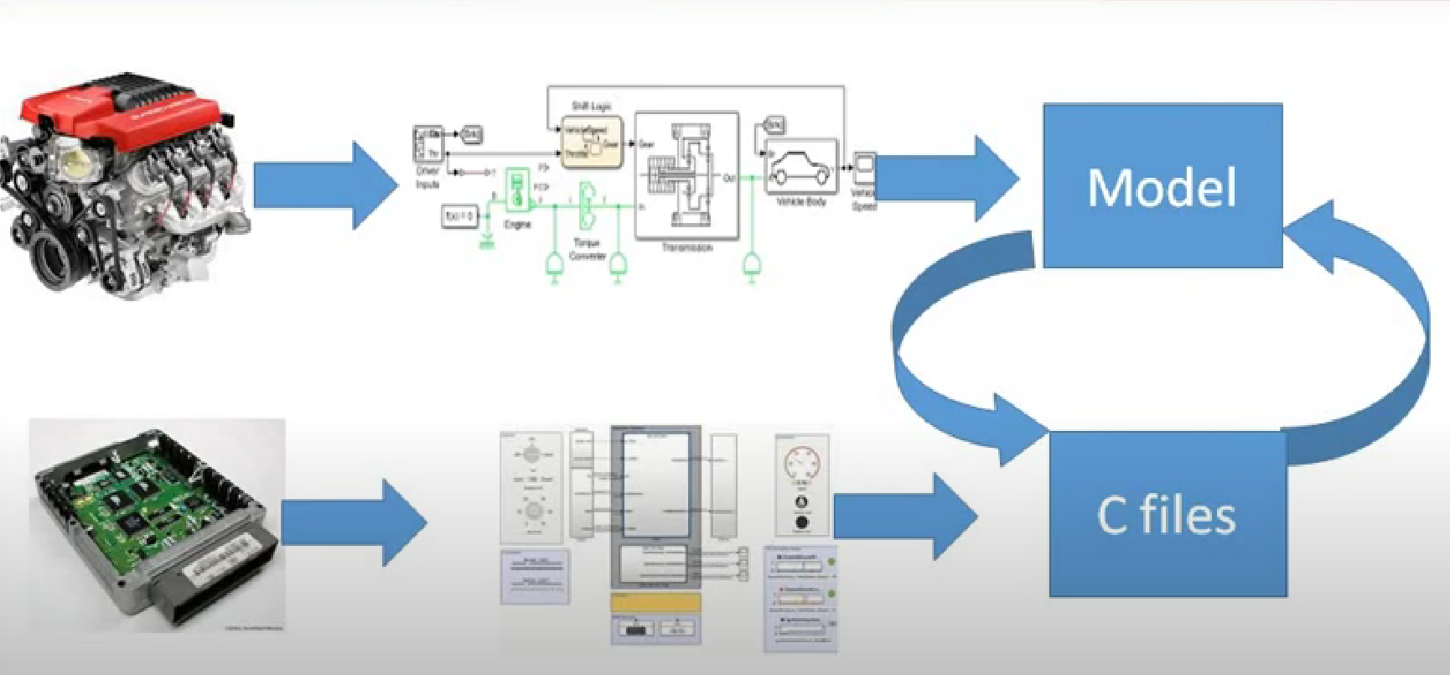
Software in Loop (SIL)
SIL:
Generate code only from the controller model and replace the controller block with this code
Rework the code if issues were found or Plant changes the implementation

Slide 5
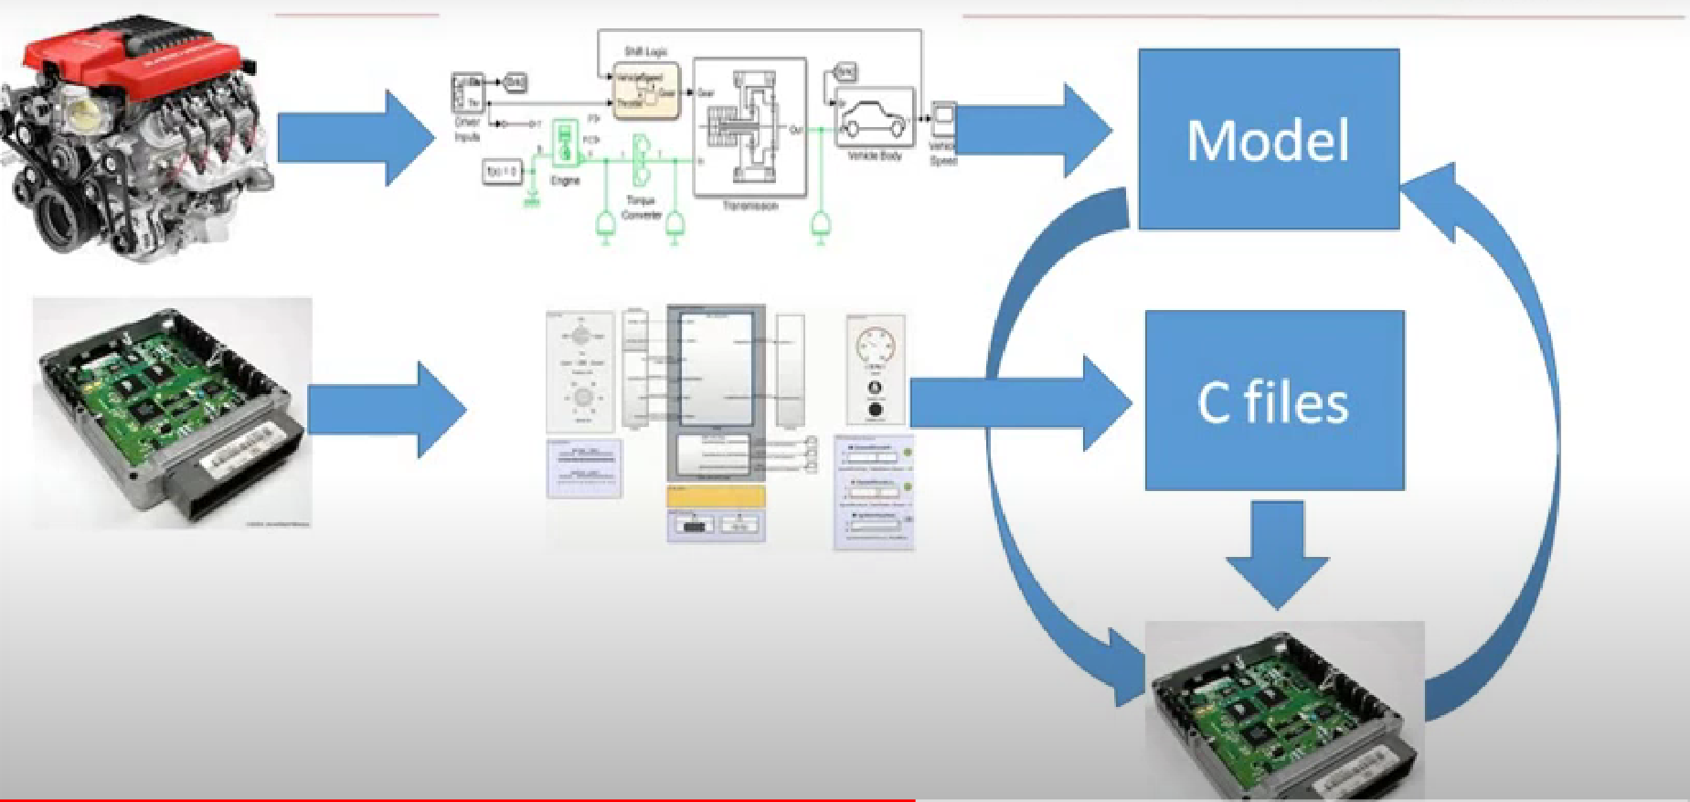
Processer in Loop (PIL)
PIL:
Put the Controller model onto an embedded processor and run a closed-loop simulation with the simulated Plant
PIL block which will have the Controller code running on the hardware
Identify if the processor is capable of running the developed Control logic. If there are glitches, then go back to the code

Slide 6
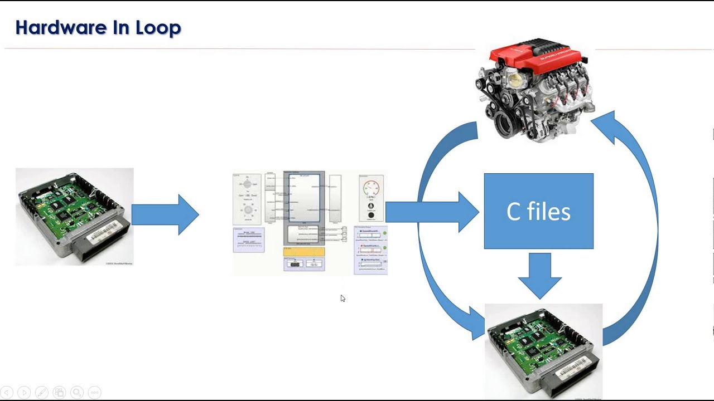
Hardware in Loop (HIL)
HIL:
Prototype or Actual Plant model
The real-time system performs simulations and have physical real connections to the embedded processor, for example analog inputs and outputs
Can identify issues related to the communication channels and I/O interface

Slide 7
Thank You

